Slide 1

Department of Computing Technologies
SRM IST, Kattankulathur – 603 203
CLA T4 Assignment
Name: Anuj Jha
Roll no: RA2111003010119
Course Code: 18CSS101J
Course Name: Programming for Problem Solving
Faculty Name: C. Vijayakumaran
Branch: CTech
Section: I Year/II Semester - B1 Section

Slide 2
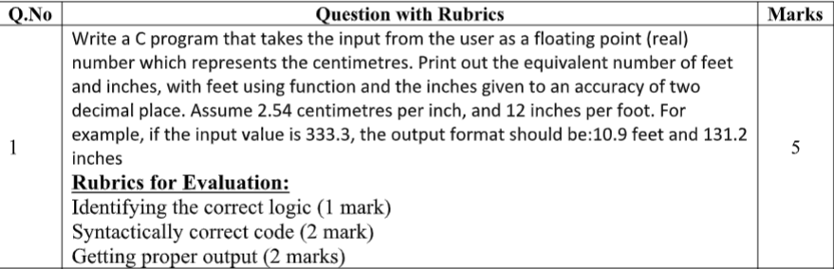
Question 1:

Slide 3
Algorithm:
Step 1: Start the program
Step 2: Take input from the user which represents distance in centimeters as float.
Step 3: Put feet = cm*0.0328084 to get distance in feet
Step 4: Put inches= cm*0.393701 to get distance in inches
Step 5: Display appropriate message and print feet and inches variable after rounding off to 2 digits.
Step 6: Stop the program

Slide 4
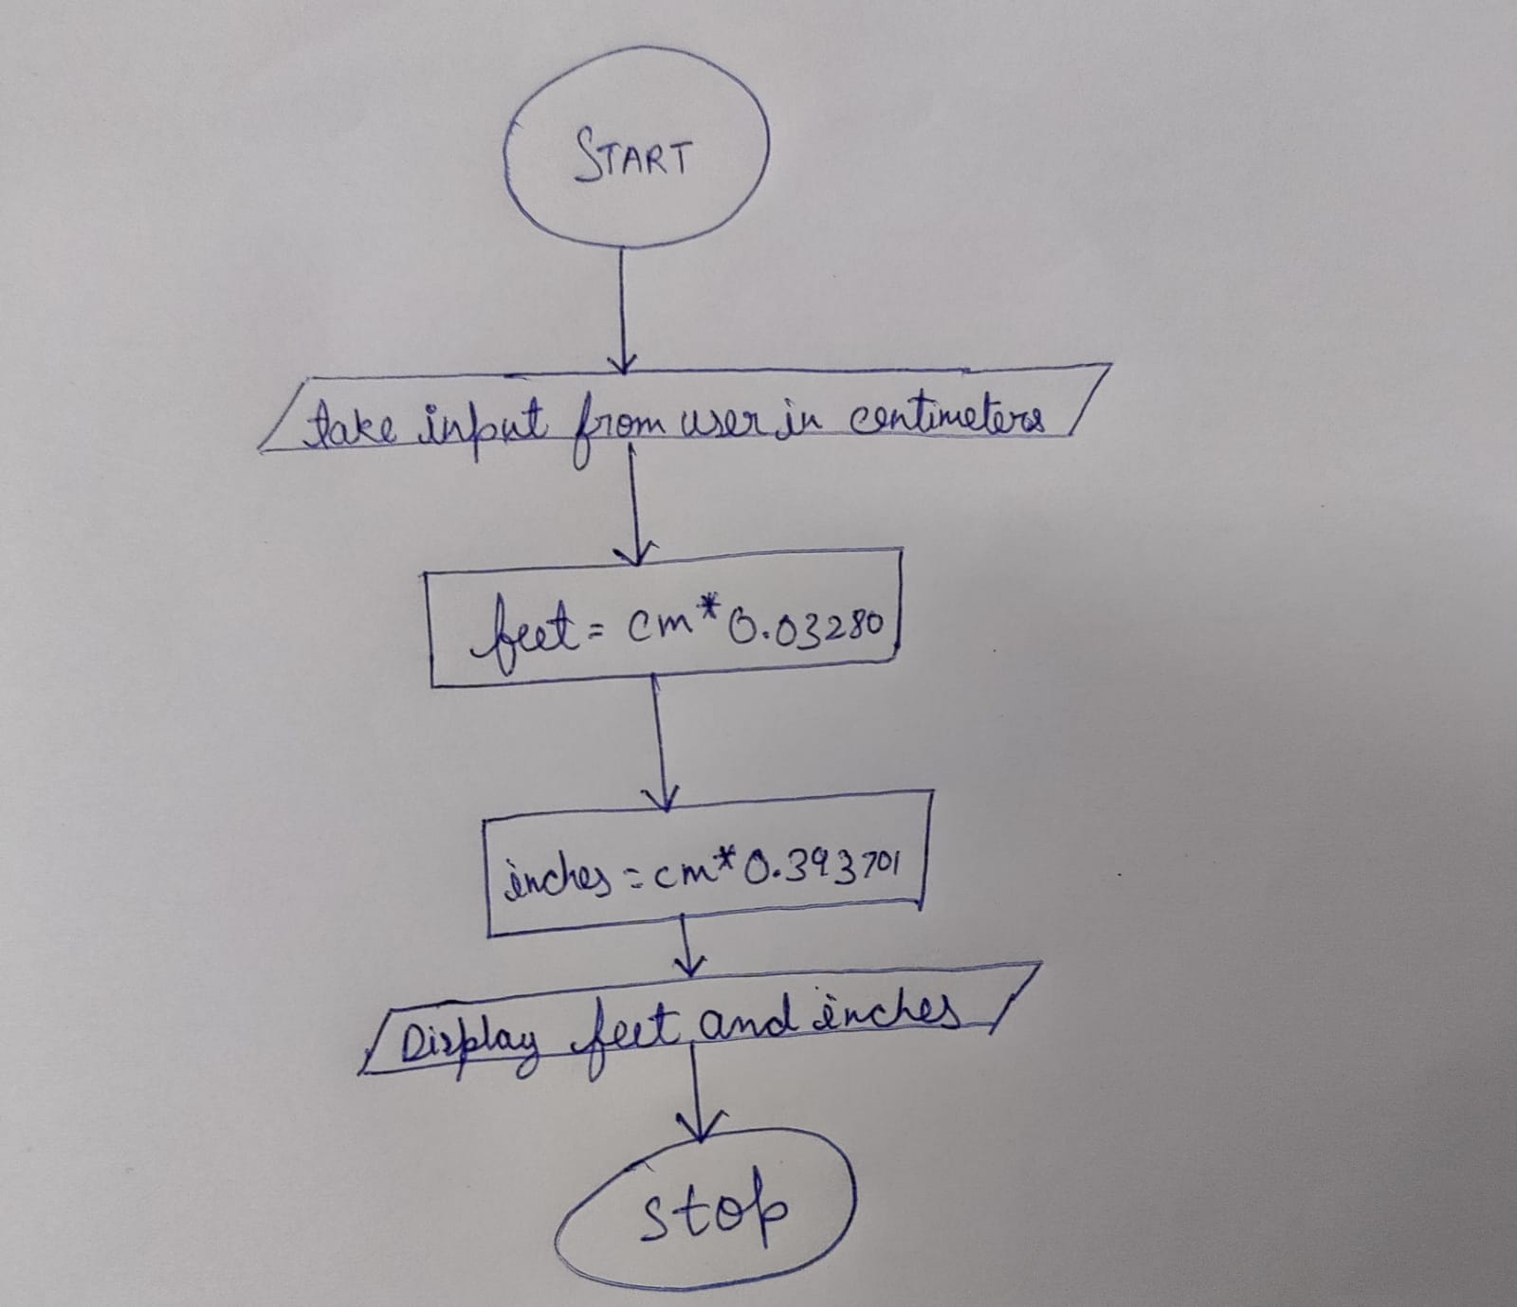
Flowchart:

Slide 5
Tokens, functions and methods of C used:
C printf() function:
The printf() function is an inbuilt library function in C language, which is used for output, i.e, to print a given statement on the console. The printf() function is defined in stdio.h (header file) in C library.
printf(“format string”,argument_list);
Format string: It is a mandatory parameter which takes value as %d (integer), %c (character), %s (string), %f (float) etc.
Argument List: It is also a mandatory parameter which includes all the variables that are required to print.
C scanf() function:
The scanf() function is an inbuilt library function in C language, which is used for input, i.e, to read the input data from the console. The scanf() function is also defined in stdio.h (header file) in C library.
Syntax:
scanf(“format string”,&argument_list);
Format string: It is a mandatory parameter which takes value as %d (integer), %c (character), %s (string), %f (float) etc.
& (Ampersand): It is added just before the variable name which represents that the data need to be feeded.
Argument List: It is also a mandatory parameter which includes all the variables in which the input data need to be feed.

Slide 6
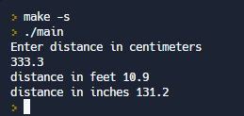
Sample Input and Output Screenshots

Slide 7
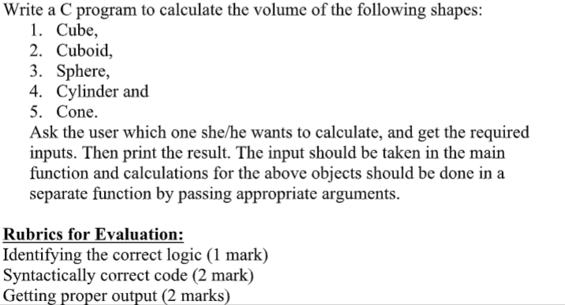
Question 5:

Slide 8
Algorithm:
Step 1: Start the program
Step 2: Create cube(int l) : a function which takes an integer and prints the value of (l*l*l)
Step 3: Create cuboid(int l,int b,int h): a function which takes three integer and prints the value of(l*b*h)
Step 4: Create Sphere(int r) taking radius , create cylinder(int r,int h),create cone(int h,int r) which prints the volume using their respective mathematical formulas.
Step 5: using switch case take input according to the shape and call the respective function.
Step 6: use break statement at end of each case.
Step 7: Stop the program

Slide 9
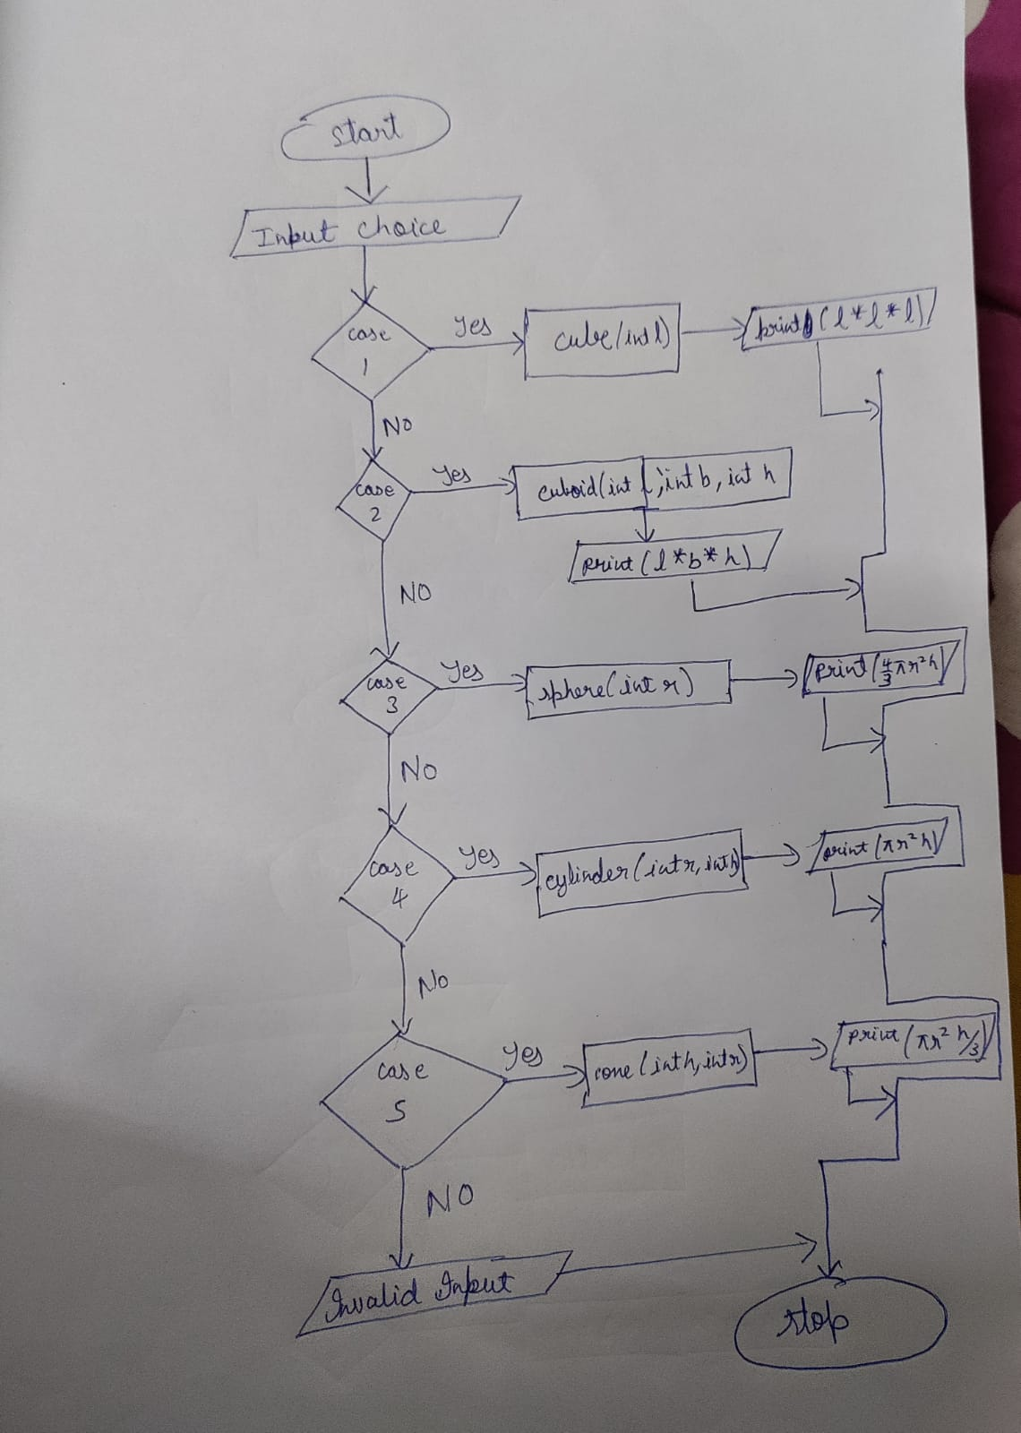
Flowchart:

Slide 10
Tokens, functions and methods of C used:
C Switch Statement
The switch statement in C is an alternate to if-else-if ladder statement which allows us to execute multiple operations for the different possibles values of a single variable called switch variable. Here, We can define various statements in the multiple cases for the different values of a single variable.
Syntax: switch(expression){
case value1:
    //code to be executed;
    break; //optional
    case value2:
    //code to be executed;
    break; //optional
    ......
    default:
    //code to be executed if all cases are not matched;
    }

Slide 11
Tokens and functions and methods of C used:
Call by value
In call by value method, the value of the actual parameters is copied into the formal parameters. In other words, we can say that the value of the variable is used in the function call in the call by value method. In call by value method, we can not modify the value of the actual parameter by the formal parameter. The actual parameter is the argument which is used in the function call whereas formal parameter is the argument which is used in the function definition.

Slide 12
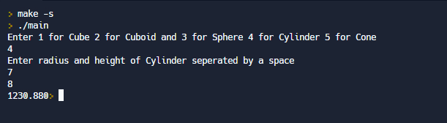
Sample Input and Output Screenshots

